Slide 1
Display Games
Mission 4

Slide 2

Pre-Mission Preparation
In the Mission 4 log, answer the pre-mission preparation questions:
Other than a computer or cellphone, what are some things that have a screen?
What are things you might want to display on a screen?

Slide 3
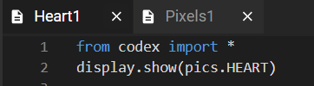
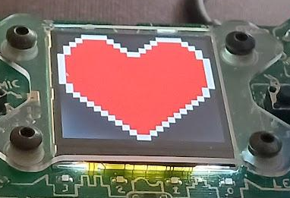
Objective #1: Back to the display
In Mission 2, your program displayed an image. The first image you displayed was a HEART.
You will practice displaying an image on the LCD screen

Slide 4
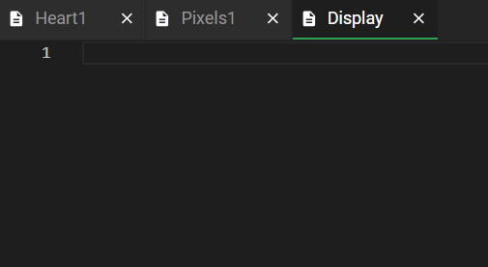
Mission Activity #1
DO THIS:
Create a new file named Display
Click the File menu button
Select “New File…”
Name the file Display
  no spaces in a file name
Click Create

Slide 5
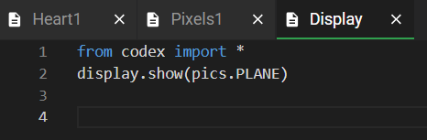
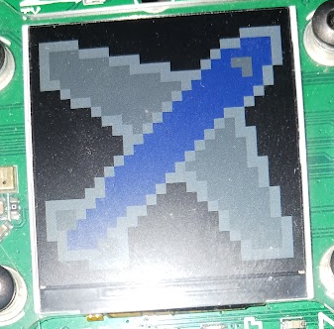
Mission Activity #1
DO THIS:
Add two lines of code to display a PLANE
Run your code

Slide 6
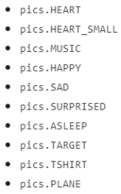
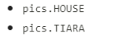
Objective #2: Text messages
3
Computers work with different types of data. So far you have worked with:
Integers (counting numbers)
CodeX images
2
279
1
33
71

Slide 7
Objective #2: Text messages
You might also want to display words.
Words, letters, and characters are the
data type string
Indicate a string by using “quotation marks”
“Hello”
“A”
“Press a button”
“My name is Joe”
“#”
“xyz”
“tacos”

Slide 8
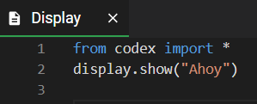
Mission Activity #2
DO THIS:
Go to the Mission Log
Write examples of different data types
Change the code in the display.show() function
to display the text “Ahoy”

Slide 9

Objective #3: Good with numbers?
A computer is very good at doing math.
When you define a variable, you assign it a value
So far you assigned a literal value
You can also assign a value by doing math

Slide 10
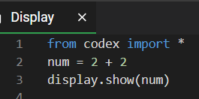
Mission Activity #3
Use a simple calculation to assign a value to a variable
DO THIS:
Add a line of code that uses the assignment statement shown on the last slide
Use the display.show() statement to show the num variable

Slide 11
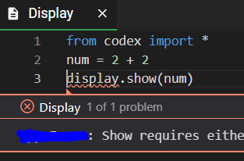
Mission Activity #3
The code caused an error
DO THIS:
Go to your Mission Log and write the error message

Slide 12
Objective #4: Converting types
Why does display.show(num) not work?
display.show(“Ahoy”) works
  “Ahoy” is a type string
display.show(pics.HEART) works
  pics.HEART is a type CodeX image
display.show(num) does not work
  num is a type integer

Slide 13
Objective #4: Converting types
Why does display.show(num) not work?
It doesn’t work with an integer, but it will work with a string -- the type is wrong.
If an integer is converted, or changed, to a string, then display.show() will work -- no error
Python has a function that will convert (change) any value to a string
  str()
EXAMPLES:
For each of these examples, the value in the (parenthesis) is changed to a “string”
str(1)
str(num)

Slide 14
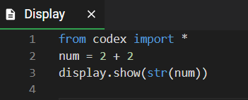
Mission Activity #4
Modify your code by using the str() conversion function
DO THIS:
Change the display.show(num) code to use the str() function
  Be careful to match your parenthesis
Run your code

Slide 15
Objective #5: Second show message
Can you display two messages?
In Mission 3, you tried showing two (or four) different colors in a pixel. This didn’t work until you slowed down the program by using a sleep().
What do you think will happen if you try to display two messages?

Slide 16
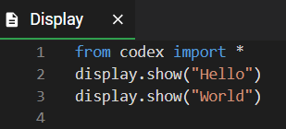
Mission Activity #5
DO THIS:
What do you think will happen if you try to print two messages?
Go to the Mission Log and write your prediction
Then change your code to display two messages:

Slide 17
Objective #6: Printing text
The display.show() command will only show one thing at a time. So, just like the pixels, the second thing is displayed on top of the first thing.
CodeX has another way to display a string
Use display.print(“string”)
All display.print(“string”) messages will be displayed, one after another -- each on its own line

Slide 18
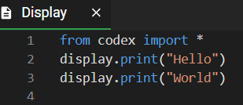
Mission Activity #6
Change your code to print the strings.
DO THIS:
Change the display.show() command to display.print()

Slide 19

Typed and Printed quiz
So far you have learned about Python data types and the display.print() command.
Answer the quiz questions
CODEX
QUIZ

Slide 20
Objective #7: Branching
During the next objectives, you will create a button-pressing game. Here are the parts of the game:
Display a button to press.
Press and hold the button. You will have one second.
If the correct button is pressed, light a pixel GREEN, otherwise light the pixel RED

Slide 21
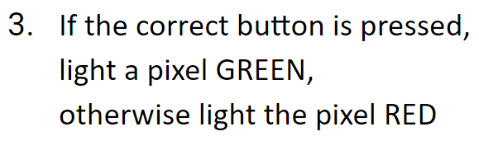
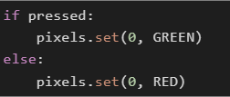
Objective #7: Branching
Step #3 is a new concept -- branching.
Branching is when the computer makes a choice between two things.
Here is an example of branching.
Notice the indenting -- this is very important!

Slide 22
Objective #7: Branching
Notice the colon(:) after the if and else
Take a closer look at branching:
This is a condition that will be True or False
The IF part will run when the condition is True
The ELSE part will run when the condition is False

Slide 23
Objective #7: Branching
Now you know four data types:
Integer
  1, 54, 720
CodeX image
  pics.HEART, pics.MUSIC
String
  “Hello”, “Press A”, “cake”
Boolean
  True, False
In this example, pressed will be either True or False
(no “quotations”)
This is a data type: Boolean

Slide 24
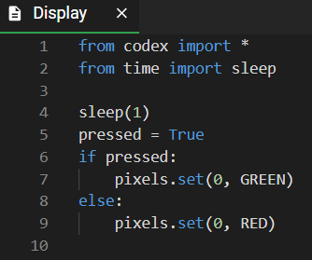
Mission Activity #7
The best way to learn about branching is to try it:
DO THIS:
Delete most of your code and type the code to the right
Run the code
  Do you see a GREEN light?
Change line 5 to pressed = False
Run the code
  Do you see a RED light?

Slide 25
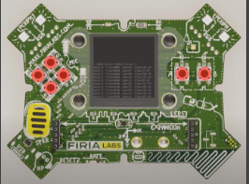
Objective #8: Button hunting
The game will use any four of the six buttons.
Look at the picture of the CodeX.
Can you find all 6 buttons?

Slide 26
Mission Activity #8
DO THIS:
Close the instructions panel
Use the camera to rotate the CodeX until you see the front
Click on all 6 buttons

Slide 27
Objective #9: Gamer input
There are 2 ways to check for a button press:
buttons.was_pressed(BTN_A)
  Checks to see if button A was pressed since the last check
buttons.is_pressed(BTN_A)
  Checks to see if button A is currently pressed
Any of the 6 buttons can be checked in ( ).

Slide 28
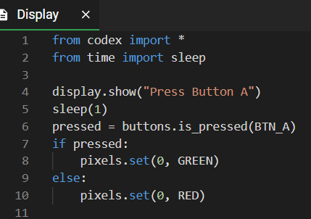
Mission Activity #9
For this game, you will check for currently pressed
DO THIS:
Add line 4
Change line 6
Run the code and press Button A
Run the code again and do not press Button A
Do you get the results you expect?

Slide 29
Buttons and Branching quiz
You have been learning about branching and checking for pressed buttons.
Answer the two quiz questions
CODEX
QUIZ

Slide 30
Objective #10: For the win!
Now just check a few more buttons and you have a serious twitch game!
You can use whatever buttons you want
You have 6 buttons to choose from:
  BTN_A, BTN_B,
  BTN_L, BTN_R, BTN_U, BTN_D
What 4 buttons do you want to use for your game?

Slide 31
Mission Activity #10
DO THIS:
Go to the Mission Log and record the four buttons you will use for your game

Slide 32
Mission Activity #10
DO THIS:
In your code, copy line 4 through line 10
Paste the code below line 10
Change Button A to the second button you want to use
  Change it in the display.show()
  Change it in buttons.is_pressed
Change the pixel from 0 to 1

Slide 33
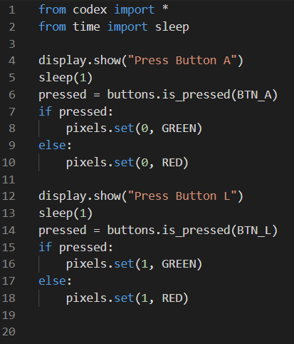
Mission Activity #10
DO THIS:
Paste the code again, below the current code
Change the button to the third button you want to use
  Change it in the display.show()
  Change it in buttons.is_pressed
Change the pixel to 2

Slide 34
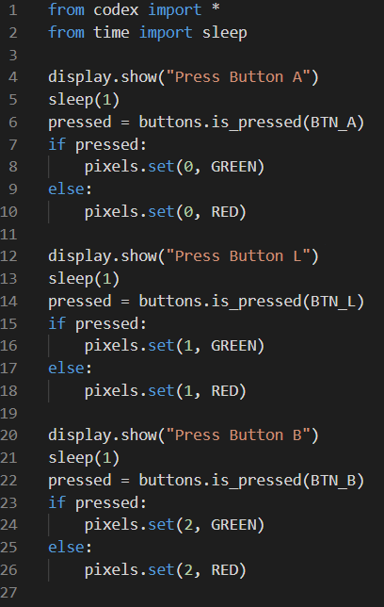
Mission Activity #10
DO THIS:
Paste the code one more time, below the current code
Change the button to the fourth button you want to use
  Change it in the display.show()
  Change it in buttons.is_pressed
Change the pixel to 3

Slide 35
Mission Activity #10
At this point you should have code for the four buttons you chose.
DO THIS:
Run the code
If you have any errors, fix them
Try pressing all the buttons and getting all green lights
Try the code again, missing some of the buttons
Do you get the results you expect?
Make any changes you need to so that your program works correctly
Have someone else try your game

Slide 36
Post-Mission Reflection
Read the “completed mission” message and click to complete the mission
Complete the Mission 4 Log

Slide 37
Clearing your CodeX
Go to FILE -- BROWSE FILES
Select the “Clear” file and open it
Run the program to clear the CodeX

